Slide 1
Decision Trees, Random Forest and Ensemble Methods
WQD 7006

Slide 2
Decision trees
Non-linear classifier - Target function is discrete valued
Easy to use
Easy to interpret
Susceptible to overfitting but can be avoided.
Examples:
  Medical diagnosis
  Credit risk analysis
  Natural Language Processing

Slide 3
Anatomy of a decision tree
Each node is a test on
one attribute
Outlook
sunny
overcast
rain
Possible attribute values
of the node
Humidity
Yes
Windy
high
normal
true
false
Leafs (class) are the decisions
No
Yes
No
Yes

Slide 4
Anatomy of a decision tree
Sample size
Each node is a test on
one attribute
Outlook
Your data
gets smaller
sunny
overcast
rain
Possible attribute values
of the node
Humidity
Yes
Windy
high
normal
true
false
Leafs are the decisions
No
Yes
No
Yes

Slide 5
To ‘play tennis’ or not.
Test example:
(Outlook==rain) and
(Windy==false)
Decision is yes.
Outlook
sunny
overcast
rain
Humidity
Yes
Windy
high
normal
true
false
No
Yes
No
Yes

Slide 6
To ‘play tennis’ or not.
(Outlook ==overcast) -> yes
(Outlook==rain) and (not Windy==True) ->yes
(Outlook==sunny) and (Humidity=normal) ->yes
Outlook
sunny
overcast
rain
Humidity
Yes
Windy
high
normal
true
false
No
Yes
No
Yes

Slide 7
Day
Outlook
Temp.
Humidity
Wind
Play Tennis
D1
Sunny
Hot
High
Weak
No
D2
Sunny
Hot
High
Strong
No
D3
Overcast
Hot
High
Weak
Yes
D4
Rain
Mild
High
Weak
Yes
D5
Rain
Cool
Normal
Weak
Yes
D6
Rain
Cool
Normal
Strong
No
D7
Overcast
Cool
Normal
Weak
Yes
D8
Sunny
Mild
High
Weak
No
D9
Sunny
Cold
Normal
Weak
Yes
D10
Rain
Mild
Normal
Strong
Yes
D11
Sunny
Mild
Normal
Strong
Yes
D12
Overcast
Mild
High
Strong
Yes
D13
Overcast
Hot
Normal
Weak
Yes
D14
Rain
Mild
High
Strong
No

Slide 8
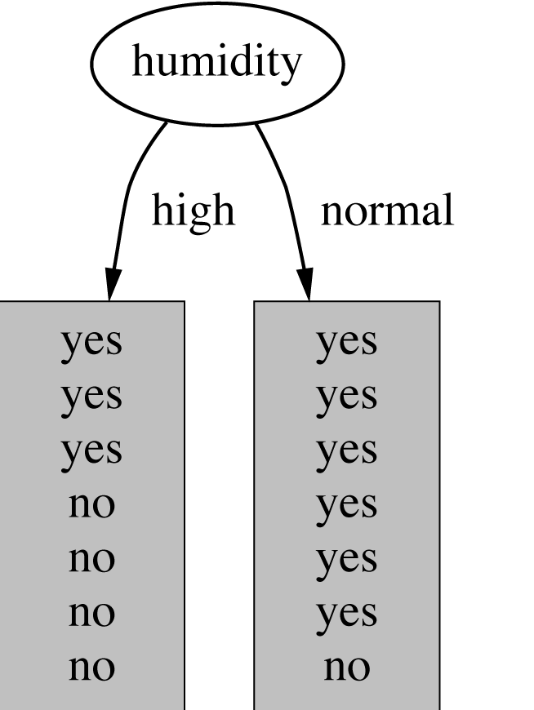
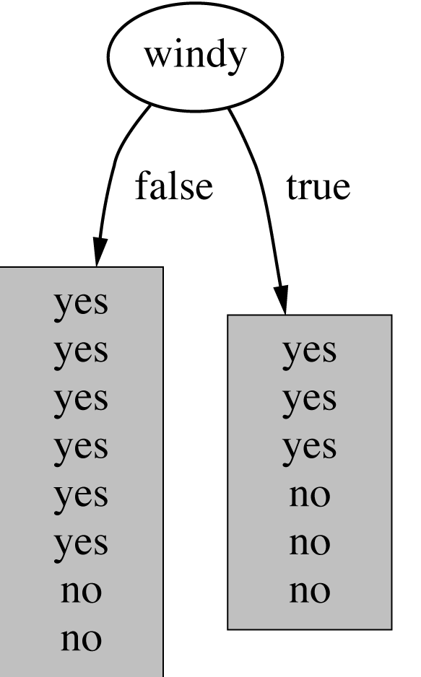
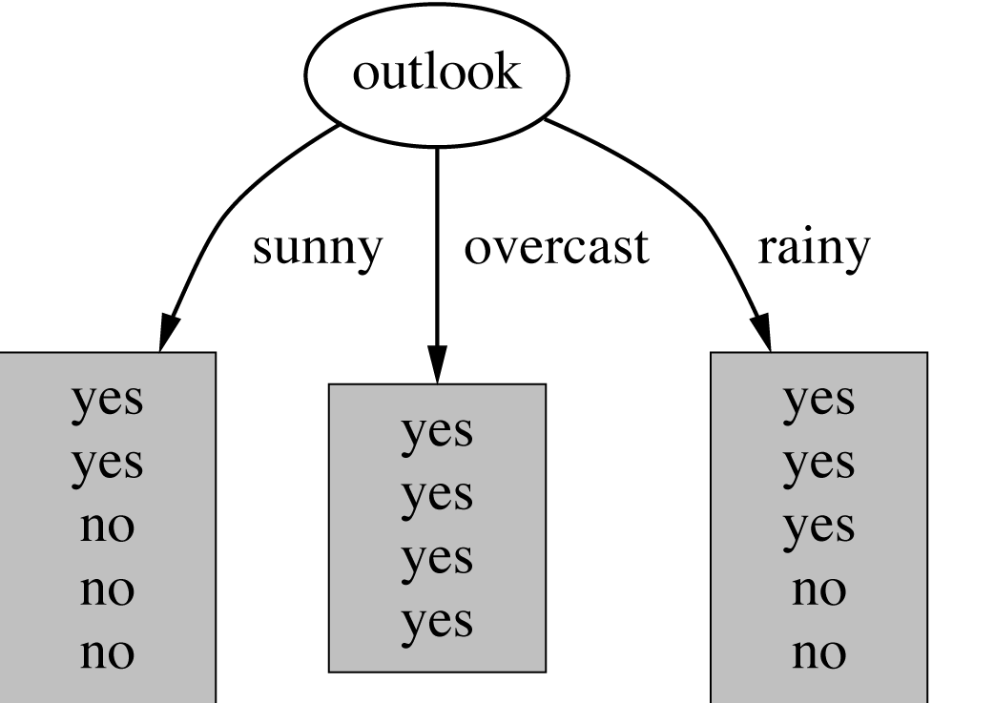
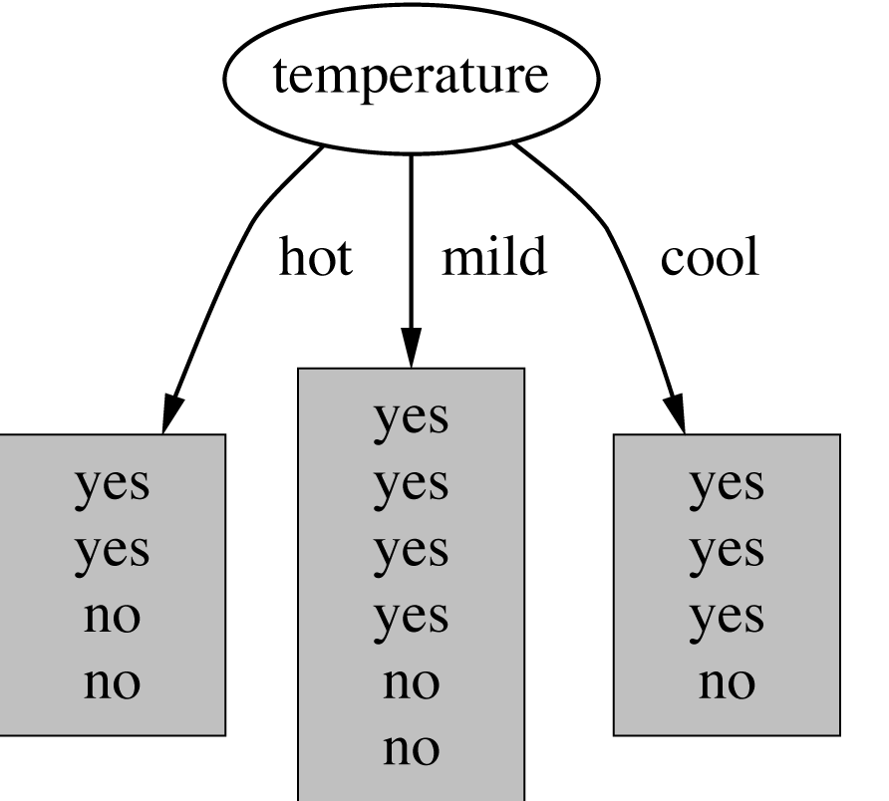
How do we choose the test ?
Which attribute should be used as the test?
Intuitively, you would prefer the
one that separates the training
examples as much as possible.

Slide 9
Im(purity) Measures
Gini
Information gain/entropy (Learn this - Homework)
Chi-square test

Slide 10
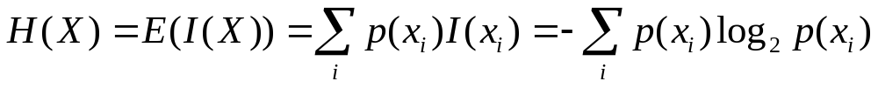
Entropy
Entropy measures the amount of uncertainty
in a probability distribution

Slide 11
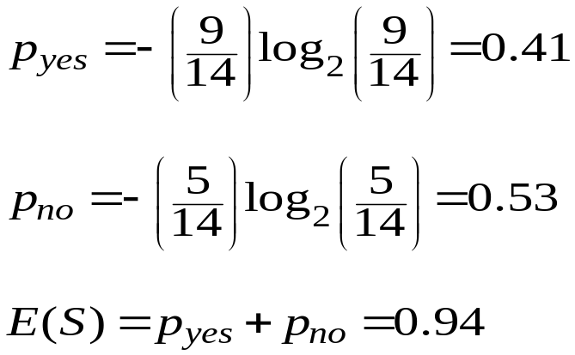
Entropy
Play Tennis dataset - two target classes: yes and no
Out of 14 instances, 9 classified yes, rest no
Outlook | Temp. | Humidity | Windy | Play
Sunny | Hot | High | False | No
Sunny | Hot | High | True | No
Overcast | Hot | High | False | Yes
Rainy | Mild | High | False | Yes
Rainy | Cool | Normal | False | Yes
Rainy | Cool | Normal | True | No
Overcast | Cool | Normal | True | Yes
Outlook | Temp. | Humidity | Windy | play
Sunny | Mild | High | False | No
Sunny | Cool | Normal | False | Yes
Rainy | Mild | Normal | False | Yes
Sunny | Mild | Normal | True | Yes
Overcast | Mild | High | True | Yes
Overcast | Hot | Normal | False | Yes
Rainy | Mild | High | True | No

Slide 12
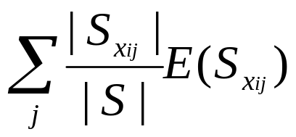
Information Gain
The expected reduction in entropy caused by partitioning the instances from S according to a given discrete variable.
Gain(S, X_{i}) = E(S) -
where S_{xij} is the subset of instances from S s.t. X_{i}=x_{ij.}
Information gain =
(information before split) – (information after split)
Notes:
A
C B
C
B A
A

Slide 13
Selecting the Next Attribute
S=[9+,5-]
E=0.940
S=[9+,5-]
E=0.940
Humidity
Wind
High
Normal
Weak
Strong
[3+, 4-]
[6+, 1-]
[6+, 2-]
[3+, 3-]
E=0.592
E=0.811
E=0.985
E=1.0
Gain(S,Humidity)
=0.940-(7/14)*0.985
– (7/14)*0.592
=0.151
Gain(S,Wind)
=0.940-(8/14)*0.811
– (6/14)*1.0
=0.048
Humidity provides greater info. gain than Wind = target classification.

Slide 14
Selecting the Next Attribute
S=[9+,5-]
E=0.940
Outlook
Over
cast
Sunny
Rain
[2+, 3-]
[4+, 0]
[3+, 2-]
E=0.971
E=0.0
E=0.971
Gain(S,Outlook)
=0.940-(5/14)*0.971
-(4/14)*0.0 – (5/14)*0.0971
=0.247

Slide 15
Overfitting
You can perfectly fit to any training data
Zero bias, high variance
Two approaches:
1. Pre-pruning - Stop growing the tree when further splitting the data does not yield an improvement
2. Grow a full tree, then prune the tree, by eliminating nodes (post-prune)

Slide 16
Decision tree
Not so ideal for predicting - inaccuracy
- not so flexible in classifying based on new dataset
Instability – a change in data can change the look of a tree

Slide 17
Random Forest
Create a bootstrapped dataset
Build Random Forest
Evaluate
Repeat Step 2 with more features

Slide 18
#CheckPoint on Random Forest
•Applicable to both regression and classification problems. Yes.
•Handle categorical predictors naturally. Yes.
•Computationally simple and quick to fit, even for large problems. Yes.
•No formal distributional assumptions (non-parametric). Yes.
•Can handle highly non-linear interactions and classification boundaries. Yes.
•Automatic variable selection. Yes. But need variable importance too.
•Very easy to interpret if the tree is small. NO!

Slide 19
Bagging
Bagging or Bootstrap aggregating - a technique for reducing the variance of an estimated prediction function.
  the variance in the prediction is reduced (no big loss from the random errors that a single classifier is bound to make).
Bagging:
  Sample M bootstrap samples.
  Train M different classifiers on these bootstrap samples
  For a new query, let all classifiers predict and take an average (or majority vote)

Slide 20
Bagging
A bootstrap sample is chosen at random with replacement from the data. Some observations end up in the bootstrap sample more than once, while others are not included (“out of bag”).
Bagging reduces the variance of the base learner but has limited effect on the bias.
•It’s most effective if we use strong base learners that have very little bias but high variance (unstable). E.g. trees.
•Both bagging and boosting are examples of “ensemble learners” that were popular in machine learning in the ‘90s.

Slide 21
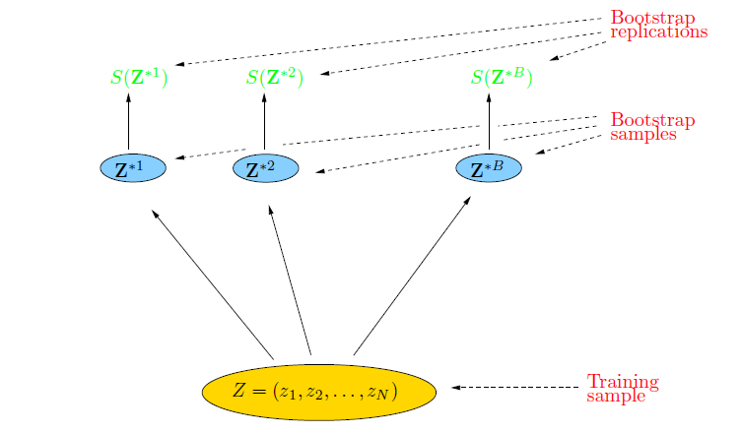
Bootstrap
The basic idea:
randomly draw datasets with replacement from the
training data, each sample the same size as the original training set

Slide 22
Bagging
Create bootstrap samples
from the training data
M features
N examples
....…

Slide 23
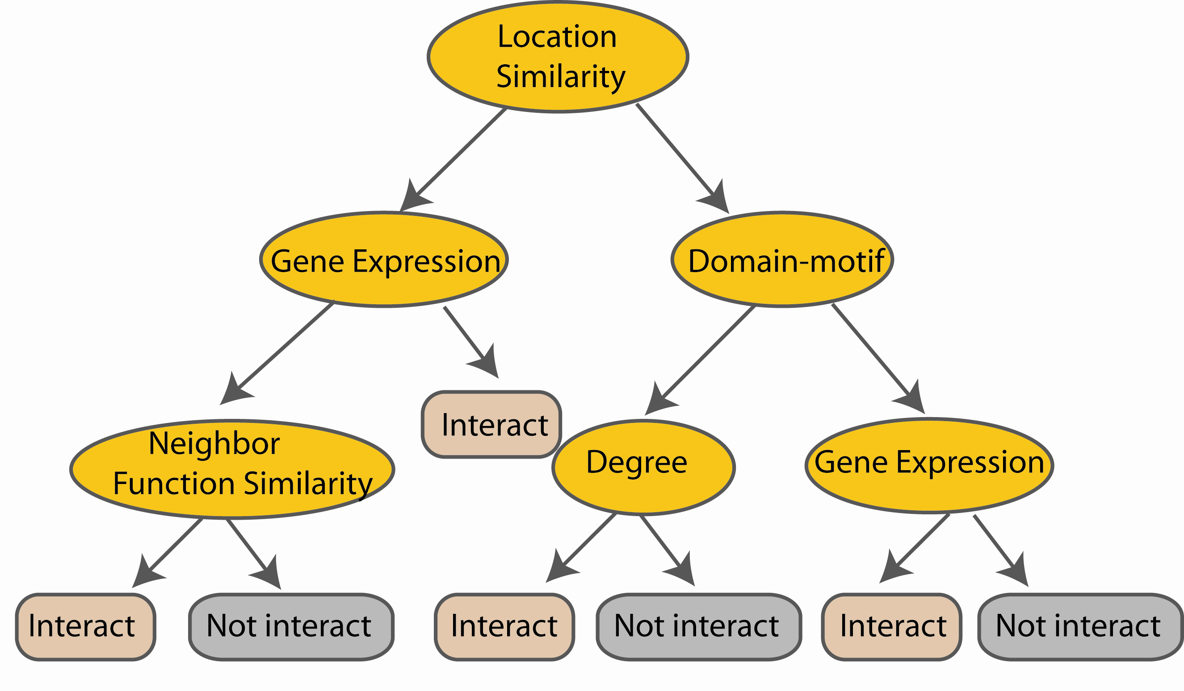
Random Forest Classifier
Construct a decision tree
M features
N examples
....…

Slide 24
Random Forest Classifier
Training Data
M features
N examples
Notes:
As the classifier of choice we adopt Random Forest Classifier, due to its robustness to heterogenous and noisy feature.
Random Forest is an ensembe classifier. Briefly, given N data and M features, bootsrap samples are created from the traning data

Slide 25
Random Forest Classifier
Create bootstrap samples
from the training data
M features
N examples
....…

Slide 26
Random Forest Classifier
Construct a decision tree
M features
N examples
....…
Notes:
From eachd descision tree .. In spliting the nodes, the Gini Gain is employed

Slide 27

Random Forest Classifier
At each node in choosing the split feature
choose only among m<M features
M features
N examples
....…
Notes:
Different from the regular decision trees in random forest, when the splitting feature is chosen from only a subset of allf eatures.
The robostness of the classifier arises from
bootsraping of the training data and the random selection of features, the the random choose of features.

Slide 28

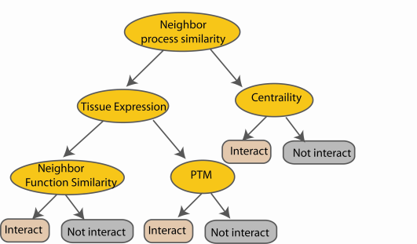
Random Forest Classifier
Create decision tree
from each bootstrap sample
M features
N examples
....…
....…

Slide 29
Random Forest Classifier
M features
N examples
Take he majority vote
....…
....…
Notes:
Finally the given an input data the decision is made as follows given an input data,

Slide 30
Additional Info - Boosting
Main idea:
train classifiers (e.g. decision trees) in a sequence.
a new classifier should focus on those cases which were incorrectly classified in the last round (get higher weights)
Each boosting round learns a new (simple) classifier on the weighed dataset.
These classifiers are weighed to combine them into a single powerful classifier.
Combine the classifiers by letting them vote on the final prediction (like bagging).
Stop by using monitoring a hold out set (cross-validation).

Slide 31
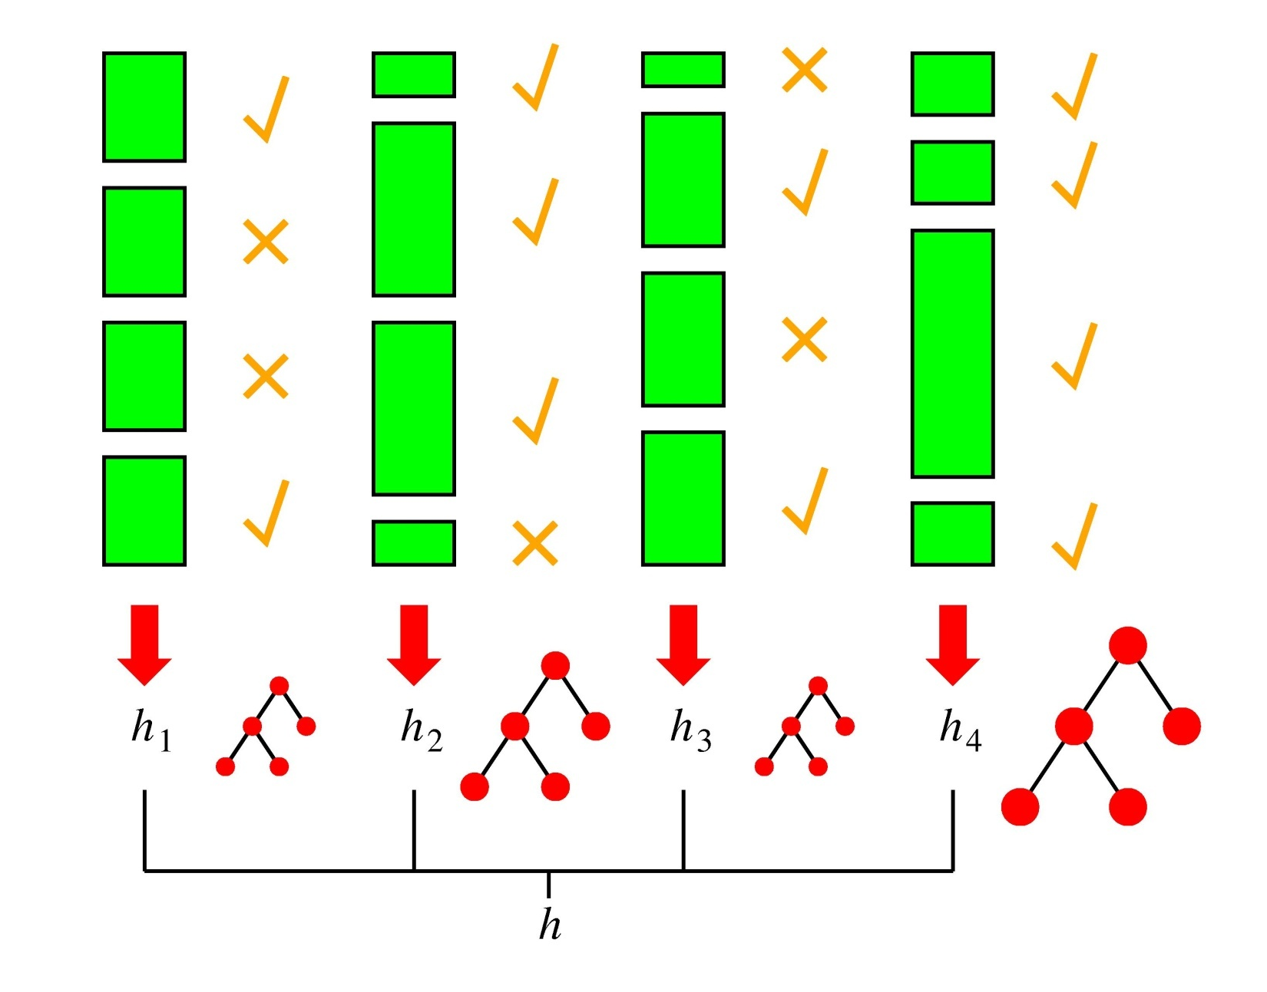
Boosting in a Picture
boosting rounds
training cases
correctly
classified
training case
has large weight
in this round
this DT has
a strong vote.

